Slide 1
Me: How are you doing?
Kelli: fine.
Notes:
What is the meaning of this message? Discuss how it might be easy to misinterpret the response “fine.”

Slide 2
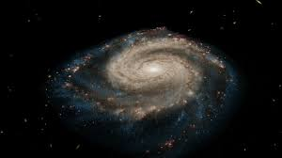
What is the universe trying to tell us?
Notes:
What do we know about the universe, the facts and the message.

Slide 3
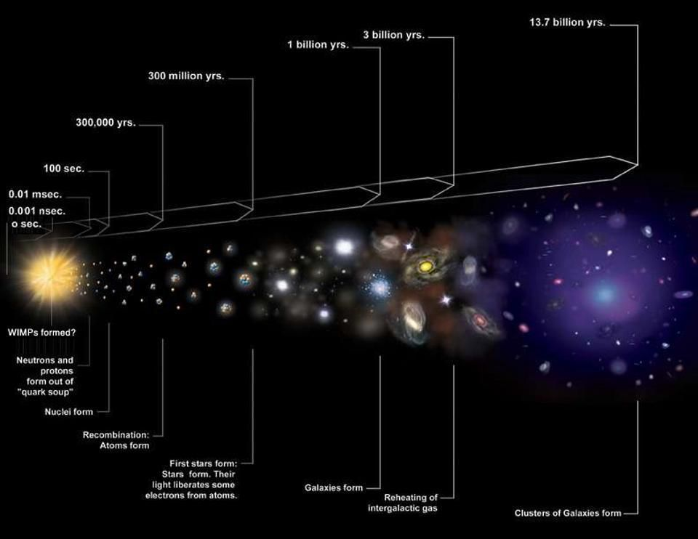
Beginning of Time
Early formation of the universe began the evolution of matter
The earliest particles were subatomic - not quite atoms
The earliest atoms were the lightest and smallest: H and then He
Notes:
Talk about the Big Bang Theory coming from singularity to present. Talk about contribution of George Lemaitre
Is there something beyond this explanation of why there is something rather than nothing?

Slide 4

Does this tell the whole story? Is the text message clear?
Notes:
Refer back to slide one. Does the text message talk about the emotions along with the content? Does the the big bang tell the whole story about the beginning of the universe?

Slide 5
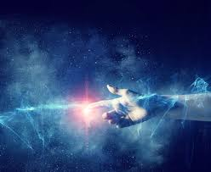
What is Creation?
Creation is the relation of dependence of all things on God, who is the source of existence itself.
God is the primary cause of the universe
The universe would not exist were it not created by God
Once the universe is in existence, the processes of nature (Laws of Nature) are known as secondary causes
Notes:
Introduce concept of Creation ex nihilo, and the distinction between making and creating. Also that God is the creator of matter (including elements), space, time, and energy. Creation is not a temporal event. NOTE that the theological concept will be discussed in detail in the sophomore religion class.

Slide 6
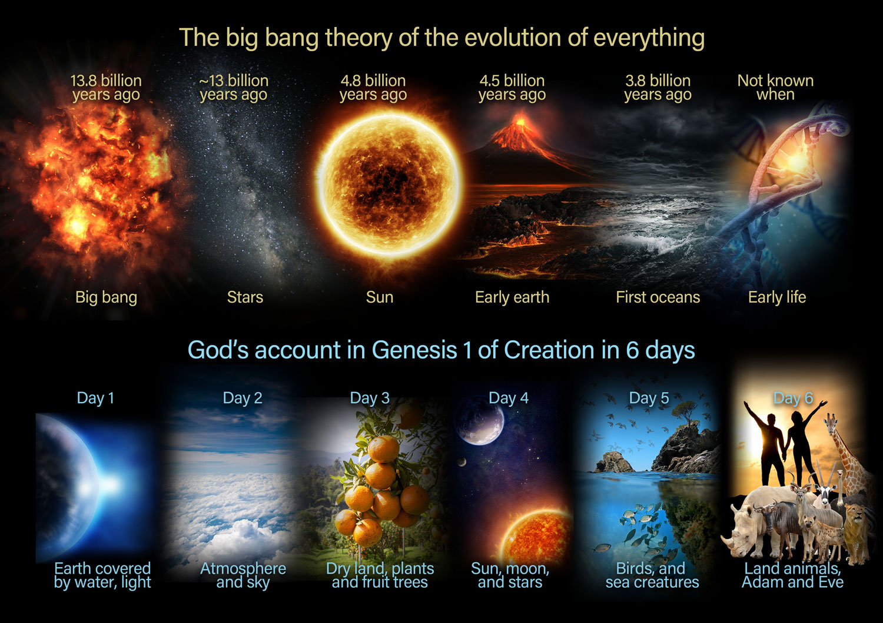
Notes:
Speak on the parallel nature of the story of Genesis and the Big Bang; but also emphasize that the Creation accounts in Genesis give us the why and by whom of the universe, while the theory of the Big Bang gives us the how and in what chronological order of the universe.
Genesis uses narrative, chronologically ordered language to express the deeper reality of this trans-temporal reality of all things’ dependence on God for their existence and order in being. (A ‘day’ in Genesis cannot be a 24 hour period)

Slide 7
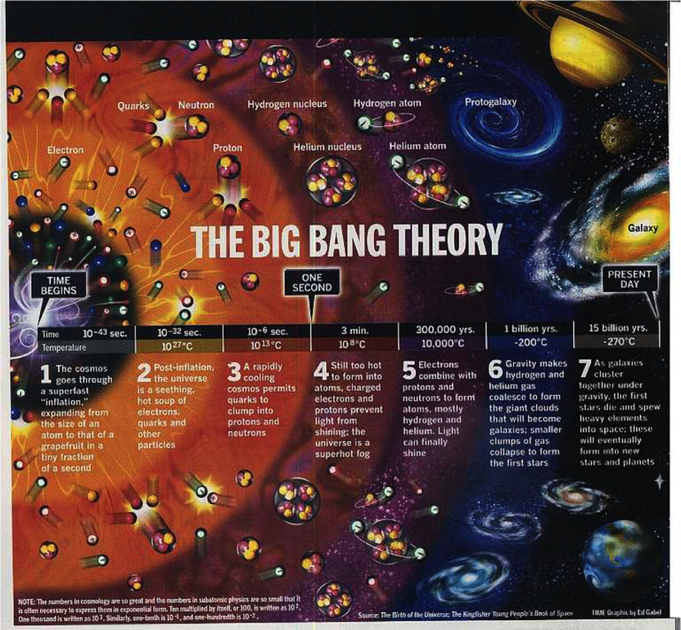
Notes:
Speak specifically about the evolution of matter, origin of elements, and the orderliness of nature.

Slide 8

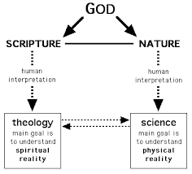
We know things by their perceivable effects
You know identity of a tree by the shape of its leaf
You know we are Christians by our love
We know God by his works: the ‘Writing’ of Nature and the Writings of Scripture
Notes:
The scientific method is one way of knowing that applies this general principle. Maybe discuss other areas of knowledge that apply this principle. e.g., a good athlete is one who performs well on the playing field; a brilliant artist is revealed in his masterpieces; a good student demonstrates his ability in speaking and writing.
Since God is the Creator of all being in its entirety (this is the meaning of Creation ex nihilo), EVERYTHING REVEALS SOMETHING ABOUT HIM. Everything is a ‘sign’ of the Creator, an intelligible message from Him. At times he speaks indirectly through nature, at other times directly through his self-communication (recorded in the books of the Bible).
Our human task is to be subtle and sophisticated interpreters of these signs/messages.

Slide 9

Can science help us understand our Creator?
Does our faith ‘fill out’ the deeper meaning of the message of the universe?
Notes:
The universe is complex and yet ordered (galaxies, stars, solar systems on the macro level; sub-atomic particles, atoms, molecules on the micro level). We can know this by observation and reflection, that is, by science. What does Revelation (God’s self-communication to us) say about these facts?

Slide 10
Psalm 19
The heavens declare the glory of God;
the firmament proclaims the works of his hands.
Day unto day pours forth speech;
night unto night whispers knowledge.
There is no speech, no words;
their voice is not heard
A report goes forth through all the earth,
their messages, to the ends of the world.
Notes:
Biblical religion sees the universe as a kerygma (message, proclamation), telling the glory of its Maker. Science as the investigation of the various layers of physical reality is a very Christian/Biblical thing to do!

Slide 11
For from the greatness and the beauty of created things
their original author, by analogy, is seen. (Wisdom 13:5)

